Slide 1
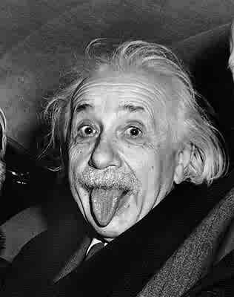
ALBERT EINSTEIN

Slide 2
Early Life
Born on March 14, 1879 in Ulm, Württemberg, Germany.(Galenet)
Although Jewish, Albert Einstein attended a Catholic School. (Galenet)
At only age 15, Einstein completed his first scientific work, “The Investigation of the State of Aether in Magnetic field.” (Galenet)
Never completed high school in hopes of applying directly to ETH Zurich. (Fara, EBSCOHOST)

Slide 3
Marriage Life
Married to Mileva Marić in January 6, 1903. (Galenet)
Has two sons, Hans Albert Einstein, and Eduard Einstein. (Galenet)
Divorced Mileva on February 14, 1919. (Galenet)
Married Elsa Löwenthal on June 2, 1919 shortly after divorcing his first wife. (Galenet)

Slide 4
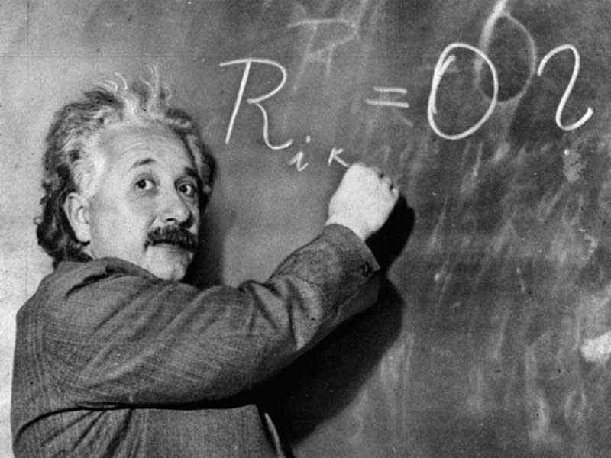
Miracle Year
Wrote 4 papers in 1905, and all them are regarded as major achievements.
  The Photoelectric Effect
  The Brownian Motion
  The Theory of Relativity
  E=MC2

Slide 5
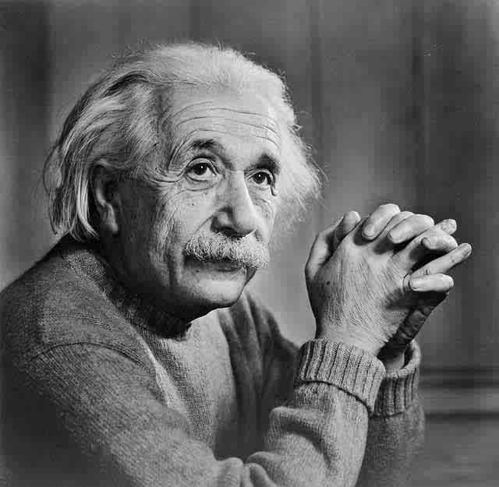
The Photoelectric Effect
Einstein hypothesized that the number of electrons released would not depend on the number of quanta, but the light’s energy. (Galenet)
Confirming his hypothesis through several experiments, Einstein won the Nobel Prize of 1921 for his works in this field. (Galenet)

Slide 6
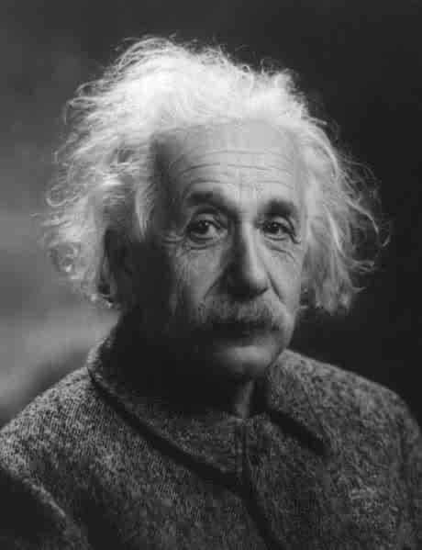
The Brownian Motion
Explained the movements of very small objects. (Galenet)
Examined molecular action that supported the Atomic Theory. (Galenet)

Slide 7
The Theory of Relativity
First assumption was that the law of physics are the same from any frame of reference. (Galenet)
Second assumption was that the velocity of light will always be the same no matter what condition measured. (Isaacson, Einstein)
From the two assumptions, Einstein derived a mathematical relationship between the velocity of an object and its length. (Isaacson, Einstein)

Slide 8
E=MC2
Energy equals mass times the speed of light squared. (Fara, EBSOCHOST)
Formula was derived due to Einstein’s realization of how closely energy and a mass of a body is connected. (Fara, EBSCOHOST)
This formula suggests that tiny amounts of mass can be converted into huge amounts of energy. (Galenet)
E=MC2

Slide 9

The Manhattan Project
Einstein wrote a letter to President Franklin D. Roosevelt informing him of a possible atomic bomb being built in Germany. (Galenet)
Einstein’s formula, E=MC2, was key in the United States developing the atomic bomb. (Galenet)

Slide 10
Awards
Throughout his career as a scientist, Einstein has won numerous awards. These are only some of what he received for his accomplishments:
  Named person of the century by Time magazine in 1999.
  The Gallop Poll recorded Einstein as the fourth most admired person in the 20th century.
  Barnard Medal of Columbia University in 1920
  Copley Medal of Royal Society in 1925
  Max Planck Medal of German Physical Society in 1929
  Gold Medal of Royal Astronomical Society in 1926
  "Albert Einstein World of Earth Science." 2008. Biography Resource Center. Gale. School Lib., King of Prussia, PA. 12 Feb. 2008 <http://infotrac.galegroup.com/itweb/?db=BioRC>.

Slide 11
Famous Quotes
True religion is real living; living with all one's soul, with all one's goodness and righteousness.
Things should be made as simple as possible, but not any simpler.
The truth of a theory is in your mind, not in your eyes.
Two things are infinite: the universe and human stupidity; and I'm not sure about the the universe.
Only a life lived for others is a life worth while.
All quotes-
http://www.thinkexist.com/English/Author/x/Author_1082_2.htm

Slide 12
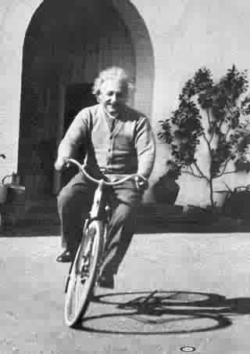
Death
Died on April 17, 1955. (Galenet)
Suffered from internal bleeding.(Galenet)
He was cremated and his ashes were scattered. (Galenet)
Before cremation, his brain was taken out by pathologist Thomas Stoltz Harvey to discover how Einstein was so smart in the future. (Van Delft, EBSCOHOST)

